Slide 1
OPERATING SYSTEM Introduction
Tanenbaum, Modern Operating Systems 3 e, (c) 2008 Prentice-Hall, Inc. All rights reserved. 0-13-6006639
Notes:
1

Slide 2
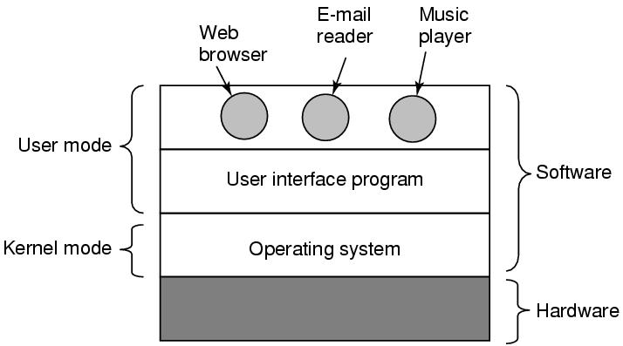
Where is the software?
Where the operating system fits in.
Tanenbaum, Modern Operating Systems 3 e, (c) 2008 Prentice-Hall, Inc. All rights reserved. 0-13-6006639

Slide 3
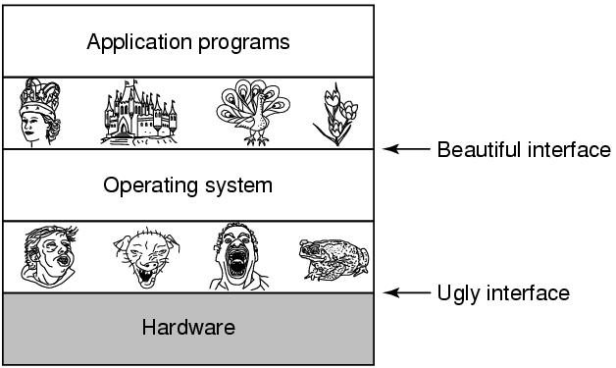
The Operating System as an Extended Machine
Tanenbaum, Modern Operating Systems 3 e, (c) 2008 Prentice-Hall, Inc. All rights reserved. 0-13-6006639

Slide 4
Abstract Machines
Abstract
Machines
Idea
Program
Result
Physical
Machine
Idea
Program
Result
…
…
…
Idea
Program
Result

Slide 5
Multiprogramming
Abstract
Machine P_{i}
Abstract
Machine P_{j}
Abstract
Machine P_{k}
…
OS Resource Sharing
P_{i} Memory
P_{k} Memory
…
Time-multiplexed
Physical Processor
P_{j} Memory
Space-multiplexed
Physical Memory

Slide 6
The OS as a Conductor
The OS coordinates the sharing and use of all the components in the computer

Slide 7
Hardware process
When the computer is powered up, it begins to execute fetch-execute cycle for the program that is stored in memory at the boot strap entry point
Hardware process is just a name to represent the iterative activity of the control unit, as it fetches and execute instructions.

Slide 8
Fetch execute algorithm
PC = <machine start address>;
IR = memory[PC];
haltFlag = CLEAR;
while(haltFlag not SET)
{
execute(IR);
PC = PC + sizeof(INSTRUCT);
IR = memory[PC]; // fetch phase
}

Slide 9
Algorithms, Programs, and Processes
Idea
Execution Engine
Files
Files
Algorithm
Files
Status
Stack
Source
Program
Binary
Program
Data
Other
Resources
Process

Slide 10
Processes
Process make things happen in linux
A process is the execution of a program(instance of running program)
A process is consists of text (machine code), data and stack
A process is said to be born when the program starts execution and remains alive as long as the program is active.
Kernel is responsible for management of process.

Slide 11
Process
Many process can run simultaneously as kernel schedules them for execution
Several processes may be instances of one program
A process reads and writes its data and stack sections, but it cannot read or write the data and stack of other processes
A process communicates with other processes and the rest of the world via system calls

Slide 12
When a process is created, the process manager algorithm creates a data structure to keep all the details it requires for managing the process.
The process descriptor is the data structure where the OS will keep all information it needs to manage that process.
What information should be kept in a process descriptor ?

Slide 13
Process descriptor
Process id | Internal name of the process
state | Process’s current state
owner | Process owner.
threads | List of threads associated with this process
List of related process | List of sibling process
List of child process | A reference to list of child of this process
Address space | A description of the address space and its binding
stack | Location of the stack in the memory

Slide 14
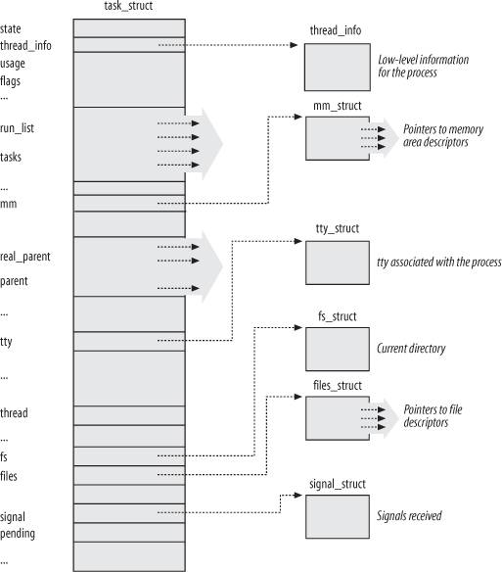
Linux Process Descriptor
Notes:
Execution of the collection of tasks - Managed by the Linux kernel
Struct task_struct is created when a process is created and it is “tied” into the list of tasks

Slide 15
State of a Process
State Variable - summary status of the process/thread which is located in descriptor
Request
Simple State Diagram
Done
Running
Request
Schedule
Allocate
Start
Blocked
Ready
Notes:
Transitions from one state to another
Running - request -> either get resource & continue running or not get resource & block

Slide 16
Process State
stopped
creation
signal
signal
executing
termination
zombie
ready
scheduling
suspended
input / output
end of
input / output

